Slide 1
Sprint 2
Classification

Slide 2
Sprint 2: Classification
Task: Predict a class from input features
Core concepts
Algorithms and models
Implementation on real dataset
Overfitting in linear classifiers
Precision/Recall trade-off
Logistic classifier
Gradient ascent
Sentiment analysis
DNA sequence classification
A. Ponsero

Slide 3
Task : Sentiment analysis
Sprint 2 - Classification

Slide 4

Book reviews sentiment analysis
Positive review
Review 1:
The story was amazing, the characters well developed and plot thrilling.
Classifier
Negative review
Sprint 2 - Classification

Slide 5
Algorithm: Linear classifiers
Sprint 2 - Classification

Slide 6
Linear Classifier
^
Y = +1
^
Output y :
Predicted class
Sentence from review
Classifier
Input x
Model
^
Y = - 1
Sprint 2 - Classification

Slide 7
Linear Classifier
Review 1:
The story was awesome, the characters well developed and plot thrilling.
Review 2:
The story was awful, and the dialogs are really badly written.
Review 3:
The story was awesome, but the ending was awful.
Sprint 2 - Classification
Notes:
So when I learn a classifier, I'm given a set of input data.
So these are sentences that have been marked to say positive or negative sentiment, and as in regression, we split it into a training set and a test set.
I feed the training set to the classifier I'm trying to learn and that algorithm is actually going to learn the weights for words.
So for example it's going to learn that good has a weight 1.0. Awesome, 1.7 Bad, -1.0. And awful, -3.3.
And then, these weights are going to be used to score every element in
the test set and evaluate how good we're doing in terms of classification.
So lets talk about what that evaluation looks like.

Slide 8
Linear Classifier
Review 1:
The story was awesome, the characters well developed and plot thrilling.
#Awful
Review 2:
The story was awful, and the dialogs are really badly written.
Review 3:
The story was awesome, but the ending was awful.
Set of reviews, plotted by the number of occurrences of “Awful” and “Awesome”
#Awsome
Sprint 2 - Classification
Notes:
So when I learn a classifier, I'm given a set of input data.
So these are sentences that have been marked to say positive or negative sentiment, and as in regression, we split it into a training set and a test set.
I feed the training set to the classifier I'm trying to learn and that algorithm is actually going to learn the weights for words.
So for example it's going to learn that good has a weight 1.0. Awesome, 1.7 Bad, -1.0. And awful, -3.3.
And then, these weights are going to be used to score every element in
the test set and evaluate how good we're doing in terms of classification.
So lets talk about what that evaluation looks like.

Slide 9
Linear Classifier
Set of reviews, plotted by the number of occurrences of “Awful” and “Awesome”
Negative review
1 * #Awsome – 1.5 #Awful = 0
#Awful
Positive review
#Awsome
Sprint 2 - Classification
Notes:
So when I learn a classifier, I'm given a set of input data.
So these are sentences that have been marked to say positive or negative sentiment, and as in regression, we split it into a training set and a test set.
I feed the training set to the classifier I'm trying to learn and that algorithm is actually going to learn the weights for words.
So for example it's going to learn that good has a weight 1.0. Awesome, 1.7 Bad, -1.0. And awful, -3.3.
And then, these weights are going to be used to score every element in
the test set and evaluate how good we're doing in terms of classification.
So lets talk about what that evaluation looks like.

Slide 10
Linear Classifier
Set of reviews, plotted by the number of occurrences of “Awful” and “Awesome”
Negative review
1 * #Awsome – 1.5 #Awful = 0
#Awful
Word | Coefficient
Awesome | 1
Awful | -1.5
Positive review
#Awsome
Sprint 2 - Classification
Notes:
So when I learn a classifier, I'm given a set of input data.
So these are sentences that have been marked to say positive or negative sentiment, and as in regression, we split it into a training set and a test set.
I feed the training set to the classifier I'm trying to learn and that algorithm is actually going to learn the weights for words.
So for example it's going to learn that good has a weight 1.0. Awesome, 1.7 Bad, -1.0. And awful, -3.3.
And then, these weights are going to be used to score every element in
the test set and evaluate how good we're doing in terms of classification.
So lets talk about what that evaluation looks like.

Slide 11
Linear Classifier
A classifier will use training data to learn a weight/coefficient for each word
Word | Coefficient
Good | 1
amazing | 1.5
bad | -1
Terrible | -2.1
Disappointing | -0.5
Book, the, we, … | 0
Review X_{i} :
The story was good, the characters well developed and plot amazing. But the ending is disappointing.
Score(X_{i}) = 1 + 1.5 - 0.5 = 2
^
Score(X_{i}) >0 → y = +1
Called a linear classifier because the output is the weighted sum of inputs
Sprint 2 - Classification

Slide 12
Linear Classifier
A classifier will use training data to learn a weight/coefficient for each word
Word | Coefficient
Good | 1
amazing | 1.5
bad | -1
Terrible | -2.1
Disappointing | -0.5
Book, the, we, … | 0
Score(X_{i}) = W₀ + w₁ x_{i}[1] + … + w_{d} x_{i}[d]
Y_{i} = sign(Score(X_{i}))
Feature 1 = 1
Feature 2 = x[1] -> #awesome
Feature 3 = x[2] -> #awful
…
Feature d+1 = x[d] -> #books
Called a linear classifier because the output is the weighted sum of inputs
Sprint 2 - Classification

Slide 13
Linear Classifier
word | weight
awesome | 2.85
great | 1.7
characters | 0
bad | -1.5
Linear classifier
Score(X1) = 2.85 x (#awesome) + 1.7 x (#great) + …
>X1
“This book was awesome, and the characters were great. The writing was OK”
Y1 = Positive classification
If Score(X1) > 0 → y_{i} = +1
If score(X1) < 0 → y_{i} = -1
Sprint 2 - Classification

Slide 14
Machine learning and classification
Training dataset
x
Feature extraction
h (x)
ML model
^
y
Predicted class
review
sentence
words
w
Word weights
ML algorithm
y
review
sentiment
Quality metric
Sprint 2 - Classification

Slide 15
Algorithm: Logistic Regression
Sprint 2 - Classification

Slide 16
Probabilistic classification model
The book and this edition are awesome!
Definitely +1
Many classifiers models provide a degree of certainty :
P(y | x)
X=input sentence
Y = output label
The book was good but the edition was passable.
Not sure
Sprint 2 - Classification
Notes:
So when I learn a classifier, I'm given a set of input data.
So these are sentences that have been marked to say positive or negative sentiment, and as in regression, we split it into a training set and a test set.
I feed the training set to the classifier I'm trying to learn and that algorithm is actually going to learn the weights for words.
So for example it's going to learn that good has a weight 1.0. Awesome, 1.7 Bad, -1.0. And awful, -3.3.
And then, these weights are going to be used to score every element in
the test set and evaluate how good we're doing in terms of classification.
So lets talk about what that evaluation looks like.

Slide 17
Interpreting Score(X_{i})
Score(X_{i}) = W₀ + w₁ x_{i}[1] + … + w_{d} x_{i}[d]
-∞
0
+∞
Y_{i} = -1
Y_{i} = +1
Very sure !
Not sure !
Very sure !
Sprint 2 - Classification
Notes:
So when I learn a classifier, I'm given a set of input data.
So these are sentences that have been marked to say positive or negative sentiment, and as in regression, we split it into a training set and a test set.
I feed the training set to the classifier I'm trying to learn and that algorithm is actually going to learn the weights for words.
So for example it's going to learn that good has a weight 1.0. Awesome, 1.7 Bad, -1.0. And awful, -3.3.
And then, these weights are going to be used to score every element in
the test set and evaluate how good we're doing in terms of classification.
So lets talk about what that evaluation looks like.

Slide 18
Interpreting Score(X_{i})
Score(X_{i}) = W₀ + w₁ x_{i}[1] + … + w_{d} x_{i}[d]
-∞
0
+∞
Y_{i} = -1
Y_{i} = +1
Very sure !
Not sure !
Very sure !
P(y=+1|x_{i}) = 0
P(y=+1|x_{i}) = 1
Sprint 2 - Classification
Notes:
So when I learn a classifier, I'm given a set of input data.
So these are sentences that have been marked to say positive or negative sentiment, and as in regression, we split it into a training set and a test set.
I feed the training set to the classifier I'm trying to learn and that algorithm is actually going to learn the weights for words.
So for example it's going to learn that good has a weight 1.0. Awesome, 1.7 Bad, -1.0. And awful, -3.3.
And then, these weights are going to be used to score every element in
the test set and evaluate how good we're doing in terms of classification.
So lets talk about what that evaluation looks like.

Slide 19
Interpreting Score(X_{i})
Score(X_{i}) = W₀ + w₁ x_{i}[1] + … + w_{d} x_{i}[d]
-∞ < Scores < +∞
-∞
0
+∞
Y_{i} = -1
Y_{i} = +1
How do we link ?
Very sure !
Not sure !
Very sure !
P(y=+1|x_{i}) = 0
P(y=+1|x_{i}) = 0.5
P(y=+1|x_{i}) = 1
0 < Proba < 1
Sprint 2 - Classification
Notes:
So when I learn a classifier, I'm given a set of input data.
So these are sentences that have been marked to say positive or negative sentiment, and as in regression, we split it into a training set and a test set.
I feed the training set to the classifier I'm trying to learn and that algorithm is actually going to learn the weights for words.
So for example it's going to learn that good has a weight 1.0. Awesome, 1.7 Bad, -1.0. And awful, -3.3.
And then, these weights are going to be used to score every element in
the test set and evaluate how good we're doing in terms of classification.
So lets talk about what that evaluation looks like.

Slide 20
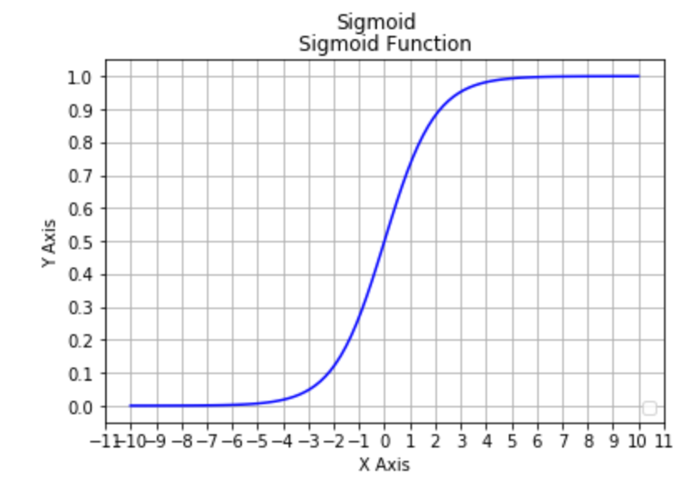
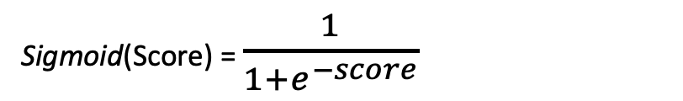
Link function: Sigmoid
Logistic regression uses a specific type of link function : the Sigmoid function
Sigmoid(Score) = $\frac{1}{1+e^{−score}}$
Score | -∞ | -2 | 0 | 2 | +∞
Sigmoid(score) | 0 | 0.12 | 0.5 | 0.88 | 1
e^{-score} | e∞=∞ |  | e⁰ = 1 |  | e ^{-∞}= 0
Sprint 2 - Classification
Notes:
So when I learn a classifier, I'm given a set of input data.
So these are sentences that have been marked to say positive or negative sentiment, and as in regression, we split it into a training set and a test set.
I feed the training set to the classifier I'm trying to learn and that algorithm is actually going to learn the weights for words.
So for example it's going to learn that good has a weight 1.0. Awesome, 1.7 Bad, -1.0. And awful, -3.3.
And then, these weights are going to be used to score every element in
the test set and evaluate how good we're doing in terms of classification.
So lets talk about what that evaluation looks like.

Slide 21
Logistic Classifier
word | weight
awesome | 2.85
great | 1.7
characters | 0
bad | -1.5
Logistic classifier
Score(X1) = 2.85 x (#awesome) + 1.7 x (#great) + …
>X1
“This book was awesome, and the characters were great. The writing was OK”
Logistic function
P(X1=positive) = 0.8
P(X1)=sigmoid (score(x))
Sprint 2 - Classification

Slide 22
Machine learning and classification
Training dataset
x
Feature extraction
h (x)
ML model
^
y
Predicted class
review
sentence
words
P(y=+1 |x,w)
w
Word weights
ML algorithm
y
review
sentiment
Quality metric
Sprint 2 - Classification

Slide 23
Algorithm: Gradient Ascent
Sprint 2 - Classification

Slide 24
Linear Classifier
How do we learn the coefficients ?
Learning model
Training set
Data
Test set
Good reviews
Bad reviews
Sprint 2 - Classification
Notes:
So when I learn a classifier, I'm given a set of input data.
So these are sentences that have been marked to say positive or negative sentiment, and as in regression, we split it into a training set and a test set.
I feed the training set to the classifier I'm trying to learn and that algorithm is actually going to learn the weights for words.
So for example it's going to learn that good has a weight 1.0. Awesome, 1.7 Bad, -1.0. And awful, -3.3.
And then, these weights are going to be used to score every element in
the test set and evaluate how good we're doing in terms of classification.
So lets talk about what that evaluation looks like.

Slide 25
Linear Classifier
How do we learn the coefficients ?
word | weight
awesome | 2.85
great | 1.7
characters | 0
bad | -1.5
Learning model
Training set
Data
Test set
Good reviews
Bad reviews
Sprint 2 - Classification
Notes:
So when I learn a classifier, I'm given a set of input data.
So these are sentences that have been marked to say positive or negative sentiment, and as in regression, we split it into a training set and a test set.
I feed the training set to the classifier I'm trying to learn and that algorithm is actually going to learn the weights for words.
So for example it's going to learn that good has a weight 1.0. Awesome, 1.7 Bad, -1.0. And awful, -3.3.
And then, these weights are going to be used to score every element in
the test set and evaluate how good we're doing in terms of classification.
So lets talk about what that evaluation looks like.

Slide 26
Linear Classifier
Finding the ”best” classifier = find w_{d} that maximize the likelihood function ℓ(w)
#awful
#awesome
Sprint 2 - Classification
Notes:
So when I learn a classifier, I'm given a set of input data.
So these are sentences that have been marked to say positive or negative sentiment, and as in regression, we split it into a training set and a test set.
I feed the training set to the classifier I'm trying to learn and that algorithm is actually going to learn the weights for words.
So for example it's going to learn that good has a weight 1.0. Awesome, 1.7 Bad, -1.0. And awful, -3.3.
And then, these weights are going to be used to score every element in
the test set and evaluate how good we're doing in terms of classification.
So lets talk about what that evaluation looks like.

Slide 27
Linear Classifier
Finding the ”best” classifier = find w_{d} that maximize the likelihood function ℓ(w)
#awful
#awesome
Sprint 2 - Classification
Notes:
So when I learn a classifier, I'm given a set of input data.
So these are sentences that have been marked to say positive or negative sentiment, and as in regression, we split it into a training set and a test set.
I feed the training set to the classifier I'm trying to learn and that algorithm is actually going to learn the weights for words.
So for example it's going to learn that good has a weight 1.0. Awesome, 1.7 Bad, -1.0. And awful, -3.3.
And then, these weights are going to be used to score every element in
the test set and evaluate how good we're doing in terms of classification.
So lets talk about what that evaluation looks like.

Slide 28
Linear Classifier
Finding the ”best” classifier = find w_{d} that maximize the likelihood function ℓ(w)
#awful
#awesome
Sprint 2 - Classification
Notes:
So when I learn a classifier, I'm given a set of input data.
So these are sentences that have been marked to say positive or negative sentiment, and as in regression, we split it into a training set and a test set.
I feed the training set to the classifier I'm trying to learn and that algorithm is actually going to learn the weights for words.
So for example it's going to learn that good has a weight 1.0. Awesome, 1.7 Bad, -1.0. And awful, -3.3.
And then, these weights are going to be used to score every element in
the test set and evaluate how good we're doing in terms of classification.
So lets talk about what that evaluation looks like.

Slide 29
Linear Classifier
Finding the ”best” classifier = find w_{d} that maximize the likelihood function ℓ(w)
#awful
To find the best model coefficients w → We use a gradient ascent algorithm !
#awesome
Sprint 2 - Classification
Notes:
So when I learn a classifier, I'm given a set of input data.
So these are sentences that have been marked to say positive or negative sentiment, and as in regression, we split it into a training set and a test set.
I feed the training set to the classifier I'm trying to learn and that algorithm is actually going to learn the weights for words.
So for example it's going to learn that good has a weight 1.0. Awesome, 1.7 Bad, -1.0. And awful, -3.3.
And then, these weights are going to be used to score every element in
the test set and evaluate how good we're doing in terms of classification.
So lets talk about what that evaluation looks like.

Slide 30
Quality metric: data likelihood
Data point | #awesome | #awful | y | Choose w to maximize
x₁ | 3 | 0 | +1 | P(y=+1 | x₁, w)
Notes:
So when I learn a classifier, I'm given a set of input data.
So these are sentences that have been marked to say positive or negative sentiment, and as in regression, we split it into a training set and a test set.
I feed the training set to the classifier I'm trying to learn and that algorithm is actually going to learn the weights for words.
So for example it's going to learn that good has a weight 1.0. Awesome, 1.7 Bad, -1.0. And awful, -3.3.
And then, these weights are going to be used to score every element in
the test set and evaluate how good we're doing in terms of classification.
So lets talk about what that evaluation looks like.

Slide 31
Quality metric: data likelihood
Data point | #awesome | #awful | y | Choose w to maximize
x₁ | 3 | 0 | +1 | P(y=+1 | x₁, w)
x₂ | 1 | 5 | -1 | P(y=-1 | x₁, w)
Notes:
So when I learn a classifier, I'm given a set of input data.
So these are sentences that have been marked to say positive or negative sentiment, and as in regression, we split it into a training set and a test set.
I feed the training set to the classifier I'm trying to learn and that algorithm is actually going to learn the weights for words.
So for example it's going to learn that good has a weight 1.0. Awesome, 1.7 Bad, -1.0. And awful, -3.3.
And then, these weights are going to be used to score every element in
the test set and evaluate how good we're doing in terms of classification.
So lets talk about what that evaluation looks like.

Slide 32
Quality metric: data likelihood
Data point | #awesome | #awful | y | Choose w to maximize
x₁ | 3 | 0 | +1 | P(y=+1 | x₁, w)
x₂ | 1 | 5 | -1 | P(y=-1 | x₁, w)
…
x_{i} | xi[1] | xi[2] | y_{i} | P(yi | xi, w)
Notes:
So when I learn a classifier, I'm given a set of input data.
So these are sentences that have been marked to say positive or negative sentiment, and as in regression, we split it into a training set and a test set.
I feed the training set to the classifier I'm trying to learn and that algorithm is actually going to learn the weights for words.
So for example it's going to learn that good has a weight 1.0. Awesome, 1.7 Bad, -1.0. And awful, -3.3.
And then, these weights are going to be used to score every element in
the test set and evaluate how good we're doing in terms of classification.
So lets talk about what that evaluation looks like.

Slide 33
Quality metric: data likelihood
Data point | #awesome | #awful | y | Choose w to maximize
x₁ | 3 | 0 | +1 | P(y=+1 | x₁, w)
x₂ | 1 | 5 | -1 | P(y=-1 | x₁, w)
…
x_{i} | xi[1] | xi[2] | y_{i} | P(yi | xi, w)
ℓ(w) = P(y₁ | x₁, w) * P(y₂ | x₂, w) * … * P(y_{i} | x_{i}, w)
Notes:
So when I learn a classifier, I'm given a set of input data.
So these are sentences that have been marked to say positive or negative sentiment, and as in regression, we split it into a training set and a test set.
I feed the training set to the classifier I'm trying to learn and that algorithm is actually going to learn the weights for words.
So for example it's going to learn that good has a weight 1.0. Awesome, 1.7 Bad, -1.0. And awful, -3.3.
And then, these weights are going to be used to score every element in
the test set and evaluate how good we're doing in terms of classification.
So lets talk about what that evaluation looks like.

Slide 34
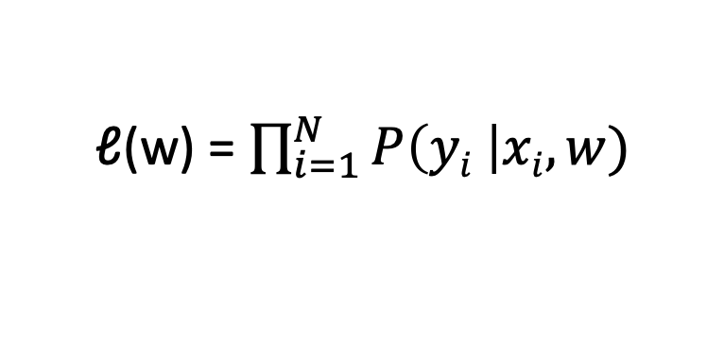
Quality metric: data likelihood
Data point | #awesome | #awful | y | Choose w to maximize
x₁ | 3 | 0 | +1 | P(y=+1 | x₁, w)
x₂ | 1 | 5 | -1 | P(y=-1 | x₁, w)
…
x_{i} | xi[1] | xi[2] | y_{i} | P(yi | xi, w)
ℓ(w) = P(y₁ | x₁, w) * P(y₂ | x₂, w) * … * P(y_{i} | x_{i}, w)
ℓ(w) = $\prod_{i=1}^{N}{P\left(yi \right|xi, w)}$
Notes:
So when I learn a classifier, I'm given a set of input data.
So these are sentences that have been marked to say positive or negative sentiment, and as in regression, we split it into a training set and a test set.
I feed the training set to the classifier I'm trying to learn and that algorithm is actually going to learn the weights for words.
So for example it's going to learn that good has a weight 1.0. Awesome, 1.7 Bad, -1.0. And awful, -3.3.
And then, these weights are going to be used to score every element in
the test set and evaluate how good we're doing in terms of classification.
So lets talk about what that evaluation looks like.

Slide 35
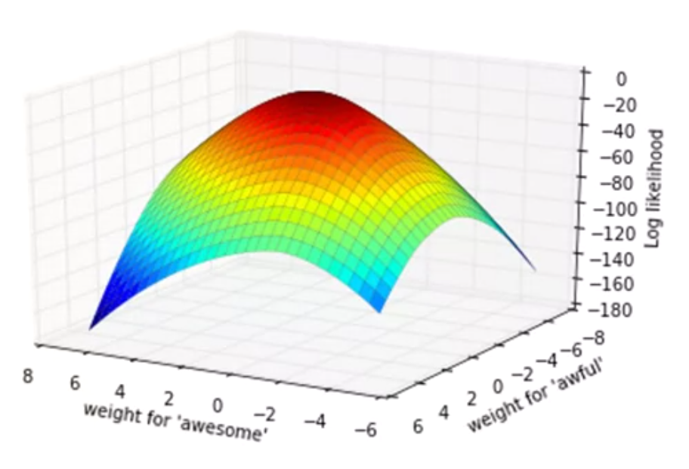
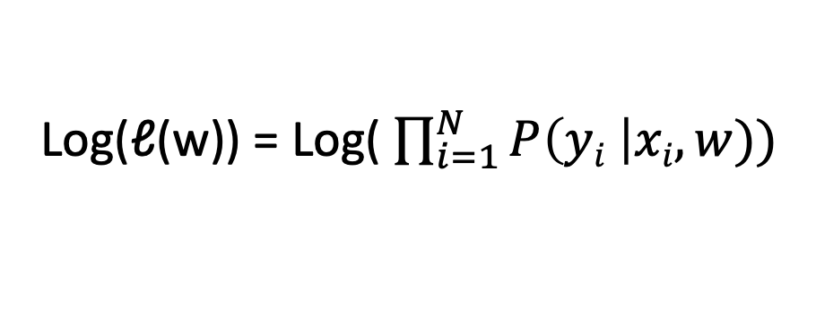
Maximizing likelihood
@Carlos Guestrin
Log(ℓ(w)) = Log( $\prod_{i=1}^{N}{P\left(yi \right|xi, w))}$
The maxima of the function can be found using the gradient ascent algorithm
w for #awful
w for #awesome
Sprint 2 - Classification
Notes:
So when I learn a classifier, I'm given a set of input data.
So these are sentences that have been marked to say positive or negative sentiment, and as in regression, we split it into a training set and a test set.
I feed the training set to the classifier I'm trying to learn and that algorithm is actually going to learn the weights for words.
So for example it's going to learn that good has a weight 1.0. Awesome, 1.7 Bad, -1.0. And awful, -3.3.
And then, these weights are going to be used to score every element in
the test set and evaluate how good we're doing in terms of classification.
So lets talk about what that evaluation looks like.

Slide 36
Machine learning and classification
Training dataset
x
Feature extraction
h (x)
ML model
^
y
Predicted class
review
sentence
words
P(y=+1 |x,w)
w
Word weights
ML algorithm
Gradient ascent
y
review
sentiment
Quality metric
Data likelihood
Sprint 2 - Classification

Slide 37
Concepts: Evaluating a classifier
Sprint 2 - Classification

Slide 38
Linear Classifier
word | weight
awesome | 2.85
great | 1.7
characters | 0
bad | -1.5
Learning model
Training set
Data
Accuracy
Test set
Good reviews
Bad reviews
How do we evaluate a model?
Sprint 2 - Classification
Notes:
So when I learn a classifier, I'm given a set of input data.
So these are sentences that have been marked to say positive or negative sentiment, and as in regression, we split it into a training set and a test set.
I feed the training set to the classifier I'm trying to learn and that algorithm is actually going to learn the weights for words.
So for example it's going to learn that good has a weight 1.0. Awesome, 1.7 Bad, -1.0. And awful, -3.3.
And then, these weights are going to be used to score every element in
the test set and evaluate how good we're doing in terms of classification.
So lets talk about what that evaluation looks like.

Slide 39
Classification error & accuracy
Model
X1 =“The book and this edition are awesome!”
Y1 = +1
Hide label
Sprint 2 - Classification
Notes:
So when I learn a classifier, I'm given a set of input data.
So these are sentences that have been marked to say positive or negative sentiment, and as in regression, we split it into a training set and a test set.
I feed the training set to the classifier I'm trying to learn and that algorithm is actually going to learn the weights for words.
So for example it's going to learn that good has a weight 1.0. Awesome, 1.7 Bad, -1.0. And awful, -3.3.
And then, these weights are going to be used to score every element in
the test set and evaluate how good we're doing in terms of classification.
So lets talk about what that evaluation looks like.

Slide 40
Classification error & accuracy
Model
Y = +1
Prediction correct
X1 =“The book and this edition are awesome!”
Y1 = +1
Hide label
Sprint 2 - Classification
Notes:
So when I learn a classifier, I'm given a set of input data.
So these are sentences that have been marked to say positive or negative sentiment, and as in regression, we split it into a training set and a test set.
I feed the training set to the classifier I'm trying to learn and that algorithm is actually going to learn the weights for words.
So for example it's going to learn that good has a weight 1.0. Awesome, 1.7 Bad, -1.0. And awful, -3.3.
And then, these weights are going to be used to score every element in
the test set and evaluate how good we're doing in terms of classification.
So lets talk about what that evaluation looks like.

Slide 41
Classification error & accuracy
Model
Y = +1
Prediction correct
X1 =“The book and this edition are awesome!”
Y1 = +1
Hide label
Model
X2 = “The book was OK.”
Y2 = -1
Hide label
Sprint 2 - Classification
Notes:
So when I learn a classifier, I'm given a set of input data.
So these are sentences that have been marked to say positive or negative sentiment, and as in regression, we split it into a training set and a test set.
I feed the training set to the classifier I'm trying to learn and that algorithm is actually going to learn the weights for words.
So for example it's going to learn that good has a weight 1.0. Awesome, 1.7 Bad, -1.0. And awful, -3.3.
And then, these weights are going to be used to score every element in
the test set and evaluate how good we're doing in terms of classification.
So lets talk about what that evaluation looks like.

Slide 42
Classification error & accuracy
Model
Y = +1
Prediction correct
X1 =“The book and this edition are awesome!”
Y1 = +1
Hide label
Model
Y = +1
Prediction error
X2 = “The book was OK.”
Y2 = -1
Hide label
Sprint 2 - Classification
Notes:
So when I learn a classifier, I'm given a set of input data.
So these are sentences that have been marked to say positive or negative sentiment, and as in regression, we split it into a training set and a test set.
I feed the training set to the classifier I'm trying to learn and that algorithm is actually going to learn the weights for words.
So for example it's going to learn that good has a weight 1.0. Awesome, 1.7 Bad, -1.0. And awful, -3.3.
And then, these weights are going to be used to score every element in
the test set and evaluate how good we're doing in terms of classification.
So lets talk about what that evaluation looks like.

Slide 43
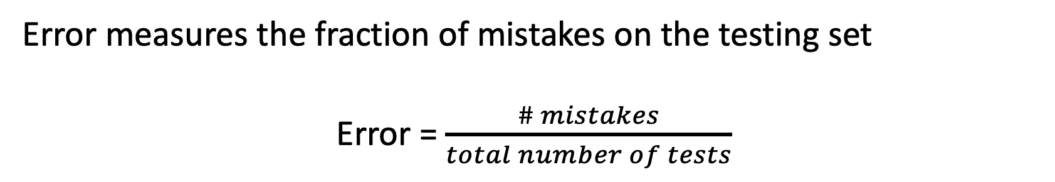
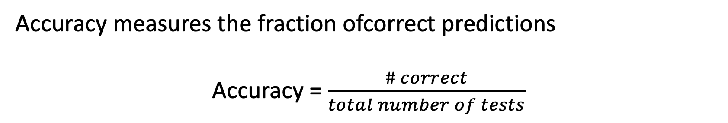
Classification error & accuracy
Error measures the fraction of mistakes on the testing set
Error = $\frac{\# mistakes}{total number of tests}$
We want it as close as 0 as possible
Accuracy measures the fraction ofcorrect predictions
Accuracy = $\frac{\# correct}{total number of tests}$
We want it as close as 1 as possible
Sprint 2 - Classification
Notes:
So when I learn a classifier, I'm given a set of input data.
So these are sentences that have been marked to say positive or negative sentiment, and as in regression, we split it into a training set and a test set.
I feed the training set to the classifier I'm trying to learn and that algorithm is actually going to learn the weights for words.
So for example it's going to learn that good has a weight 1.0. Awesome, 1.7 Bad, -1.0. And awful, -3.3.
And then, these weights are going to be used to score every element in
the test set and evaluate how good we're doing in terms of classification.
So lets talk about what that evaluation looks like.

Slide 44
Evaluating a classifier
Recall (True positive rate) : How many positive reviews did I retrieve ?
False Positive rate : How many negative reviews were identified as positives ?
Precision : How many selected items are positive reviews?
Sprint 2 - Classification
Notes:
Let's discuss how we measure error, in fact, classification error, when we're doing this classification.

Slide 45
Evaluating a classifier
Recall (True positive rate) : How many positive reviews did I retrieve ?
False Positive rate : How many negative reviews were identified as positives ?
Precision : How many selected items are positive reviews?
Recall = 26/28 = 0.92
Sprint 2 - Classification
Notes:
Let's discuss how we measure error, in fact, classification error, when we're doing this classification.

Slide 46
Evaluating a classifier
Recall (True positive rate) : How many positive reviews did I retrieve ?
False Positive rate : How many negative reviews were identified as positives ?
Precision : How many selected items are positive reviews?
FPR = 5/28 = 0.18
Sprint 2 - Classification
Notes:
Let's discuss how we measure error, in fact, classification error, when we're doing this classification.

Slide 47
Evaluating a classifier
Recall (True positive rate) : How many positive reviews did I retrieve ?
False Positive rate : How many negative reviews were identified as positives ?
Precision : How many selected items are positive reviews?
Precision= 26/31 = 0.87
Sprint 2 - Classification
Notes:
Let's discuss how we measure error, in fact, classification error, when we're doing this classification.

Slide 48
Concepts:Overfitting Classifiers and regularization
Sprint 2 - Classification

Slide 49
Learning a decision boundary
Feature | Value | Coefficient
h₀(x) | 1 | 0.23
h₁(x) | X[1] | 1.12
h₂(x) | X[2] | -1.07
X[2]
X[2]
X[1]
X[1]
Sprint 2 - Classification

Slide 50
Learning a decision boundary
Feature | Value | Coefficient
h₀(x) | 1 | 21.6
h₁(x) | X[1] | 5.3
h₂(x) | X[2] | -42.7
h₃(x) | X[1]² | -15.9
h₄(x) | X[1]² | 67.0
h₅(x) | X[1]³ | 48.0
h₆(x) | X[1]³ | 0.8
h₇(x) | X[1]⁴ | -14.2
h₈(x) | X[1]⁴ | -8.8
X[2]
X[2]
X[1]
X[1]
Sprint 2 - Classification

Slide 51
Learning a decision boundary
Feature | Value | Coefficient
h₀(x) | 1 | 21.6
h₁(x) | X[1] | 5.3
h₂(x) | X[2] | -42.7
h₃(x) | X[1]² | -15.9
h₄(x) | X[1]² | 67.0
h₅(x) | X[1]³ | 48.0
h₆(x) | X[1]³ | 0.8
h₇(x) | X[1]⁴ | -14.2
h₈(x) | X[1]⁴ | -8.8
X[2]
X[2]
X[1]
X[1]
Very often, overfitting is associated with very large estimated coefficients w
Sprint 2 - Classification

Slide 52
Overfitting
Test error
Overfitting if:
There exist a model with estimated parameters w’ such that:
Training error (w) < training error (w’)
Test error (w) > test error (w’)
Error
Training error
Model complexity
Sprint 2 - Classification

Slide 53
Overfitting
In Logistic regression, overfitting leads to over confident predictions
Score(X_{i}) = W₀ + w₁ x_{i}[1] + … + w_{d} x_{i}[d]
-∞ < Scores < +∞
-∞
0
+∞
Y_{i} = -1
Y_{i} = +1
P(y=+1 |x_{i}, w) = sigmoid(Score(X_{i}))
0 < Proba < 1
0
1
0.5
Sprint 2 - Classification

Slide 54
Concepts: L2 regularization
Sprint 2 - Classification

Slide 55
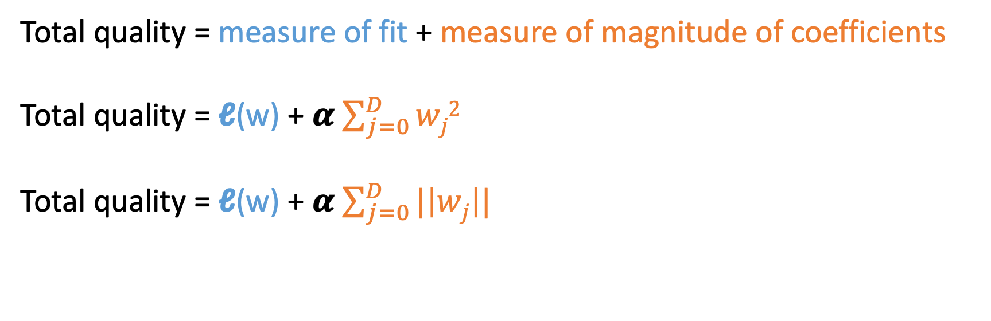
Desired total cost
We want to balance:
How well function fits the training data
The magnitude of coefficients
Total quality = measure of fit + measure of magnitude of coefficients
Total quality = ℓ(w) + 𝜶 $\sum_{j=0}^{D}{wj2}$
Total quality = ℓ(w) + 𝜶 $\sum_{j=0}^{D}{|\left|wj\right||}$
L2 norm
L1 norm
Both penalize large coefficients, but L1 norm also provides a sparse solution
Notes:
So when I learn a classifier, I'm given a set of input data.
So these are sentences that have been marked to say positive or negative sentiment, and as in regression, we split it into a training set and a test set.
I feed the training set to the classifier I'm trying to learn and that algorithm is actually going to learn the weights for words.
So for example it's going to learn that good has a weight 1.0. Awesome, 1.7 Bad, -1.0. And awful, -3.3.
And then, these weights are going to be used to score every element in
the test set and evaluate how good we're doing in terms of classification.
So lets talk about what that evaluation looks like.

Slide 56
Implementation: Sentiment analysis using logistic regression
Sprint 2 - Classification

Slide 57
Book reviews sentiment analysis
Positive review
Review 1:
The story was amazing, the characters well developed and plot thrilling.
Classifier
Negative review
Sprint 2 - Classification

Slide 58
Concepts:Training biases
Sprint 2 - Classification

Slide 59

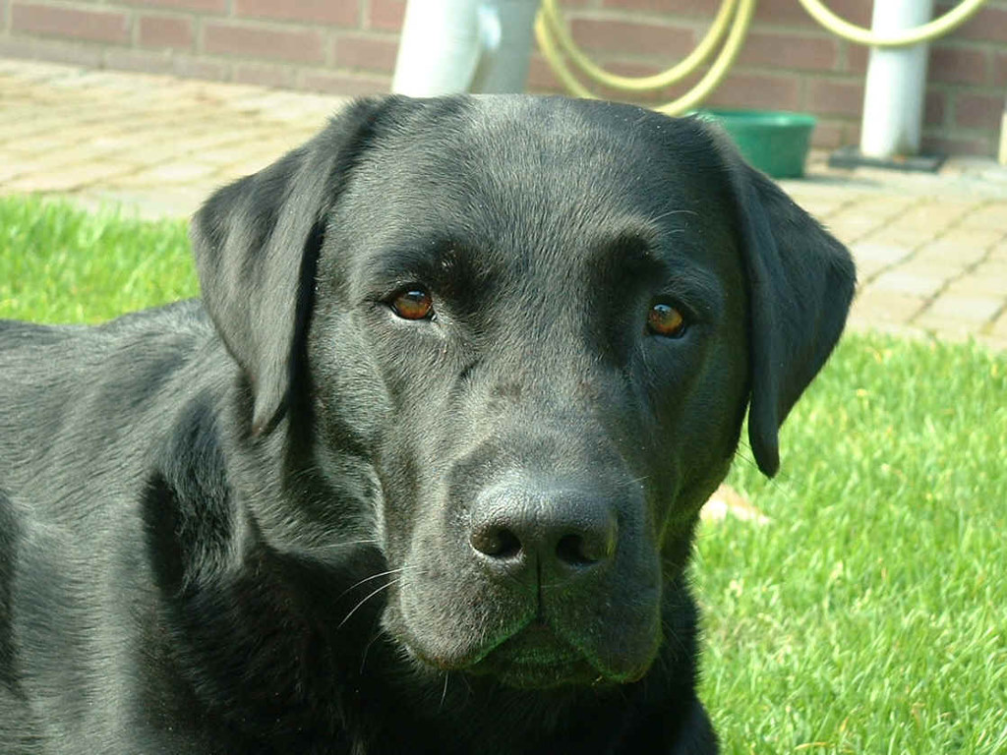



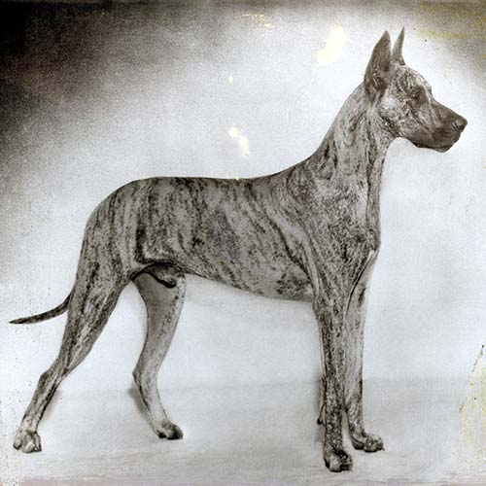

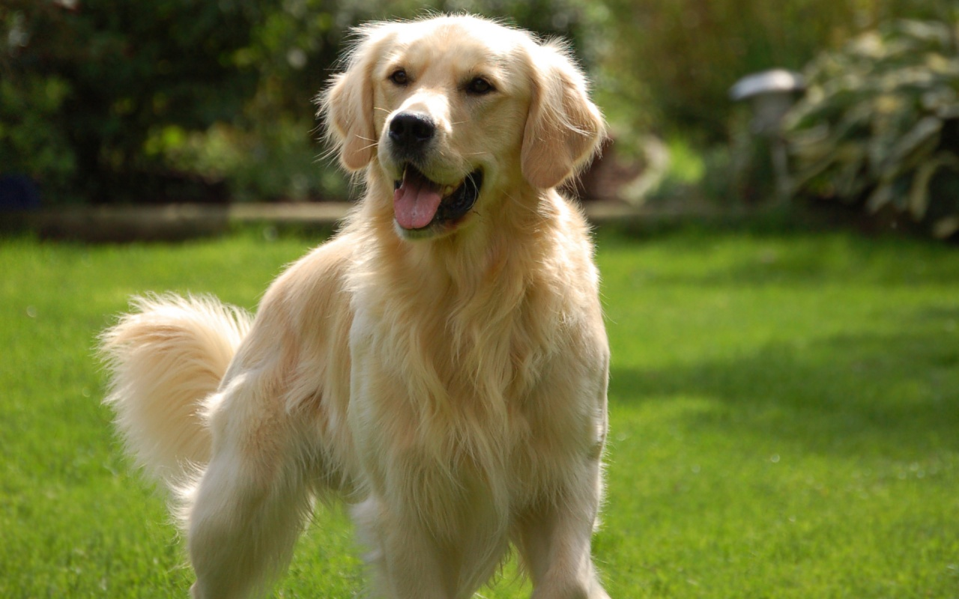
Training set composition matters
Sample bias arises when the training set doesn’t fully encompass the true variability of your object.
Training set
Sprint 2 - Classification
Notes:
https://www.coursera.org/learn/ml-foundations/lecture/PwEPC/training-and-evaluating-a-classifier

Slide 60
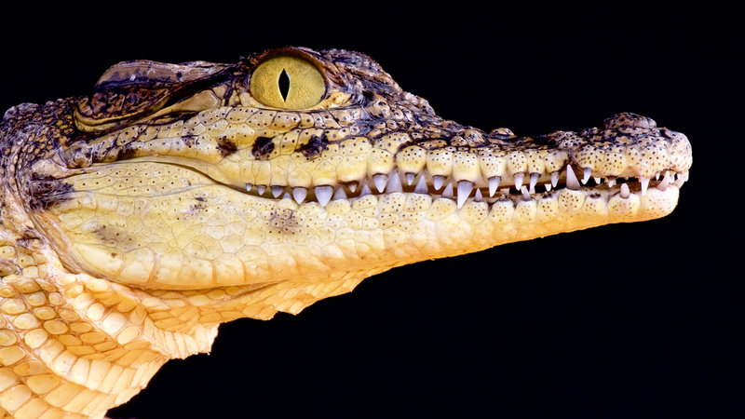
Training set composition matters
Sample bias arises when the training set doesn’t fully encompass the true variability of your object.
Training set
?
Sprint 2 - Classification
Notes:
https://www.coursera.org/learn/ml-foundations/lecture/PwEPC/training-and-evaluating-a-classifier

Slide 61
Training set composition matters
Prejudice bias arises when the training set has some inherent biases. The model will not only learn those biases but will end up amplifying them.
Training set
Sprint 2 - Classification
Notes:
https://www.coursera.org/learn/ml-foundations/lecture/PwEPC/training-and-evaluating-a-classifier

Slide 62
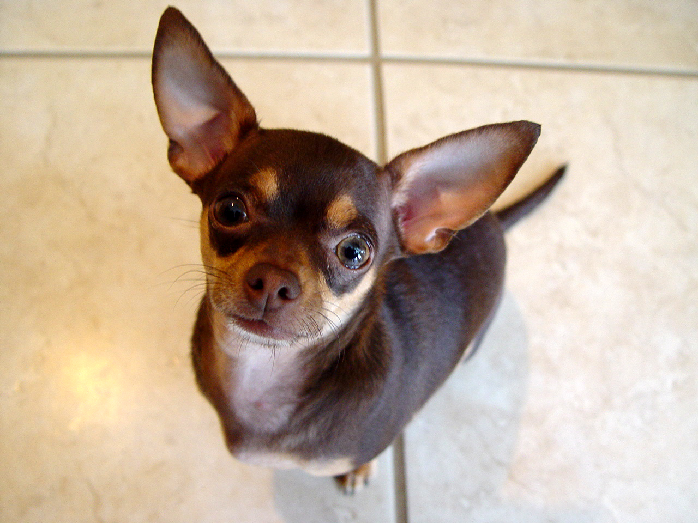
Training set composition matters
Prejudice bias arises when the training set has some inherent biases. The model will not only learn those biases but will end up amplifying them.
Training set
?
Sprint 2 - Classification
Notes:
https://www.coursera.org/learn/ml-foundations/lecture/PwEPC/training-and-evaluating-a-classifier

Slide 63
Concepts:The problem of rare events detection
Sprint 2 - Classification

Slide 64
Low abundance categories
The detection of low events is a difficult issue, leading to a drop in precision.
Model A :
TPR= 0.8
FPR= 0.12
Sprint 2 - Classification
Notes:
Let's discuss how we measure error, in fact, classification error, when we're doing this classification.

Slide 65
Low abundance categories
The detection of low events is a difficult issue, leading to a drop in precision.
Model A :
TPR= 0.8
FPR= 0.12
True Positives = 20
Sprint 2 - Classification
Notes:
Let's discuss how we measure error, in fact, classification error, when we're doing this classification.

Slide 66
Low abundance categories
The detection of low events is a difficult issue, leading to a drop in precision.
Model A :
TPR= 0.8
FPR= 0.12
True Positives = 20
False Positives = 3
Sprint 2 - Classification
Notes:
Let's discuss how we measure error, in fact, classification error, when we're doing this classification.

Slide 67
Low abundance categories
The detection of low events is a difficult issue, leading to a drop in precision.
Model A :
TPR= 0.8
FPR= 0.12
True Positives = 20
False Positives = 3
Precision = 20/23 = 0.87
Sprint 2 - Classification
Notes:
Let's discuss how we measure error, in fact, classification error, when we're doing this classification.

Slide 68
Low abundance categories
The detection of low events is a difficult issue, leading to a drop in precision.
Model A :
TPR= 0.8
FPR= 0.12
True Positives = 20
False Positives = 3
Precision = 20/23 = 0.87
Sprint 2 - Classification
Notes:
Let's discuss how we measure error, in fact, classification error, when we're doing this classification.

Slide 69
Low abundance categories
The detection of low events is a difficult issue, leading to a drop in precision.
Model A :
TPR= 0.8
FPR= 0.12
True Positives = 20
False Positives = 3
Precision = 20/23 = 0.87
Sprint 2 - Classification
Notes:
Let's discuss how we measure error, in fact, classification error, when we're doing this classification.

Slide 70
Low abundance categories
The detection of low events is a difficult issue, leading to a drop in precision.
Model A :
TPR= 0.8
FPR= 0.12
True Positives = 20
False Positives = 3
Precision = 20/23 = 0.87
True Positives = 8
False Positives = 5
Precision = 8/13 = 0.61
Sprint 2 - Classification
Notes:
Let's discuss how we measure error, in fact, classification error, when we're doing this classification.

